Slide 1




Insurance Claim Prediction
Claim

Slide 2
Objectives
The primary goal of AI in insurance claim prediction is to determine whether a person will or won't get into trouble, whether they will or won't make an insurance claim, and how much it will cost if they do.
When a customer's insurance claim is denied, they want to know why and what factors contributed to the decision. This is the process of AI in Insurance Claim Prediction.
Benefits
Predict a person's insurance claims
Explains the reasons the claim was denied
How the parameters relate to one another.
Provides values that aid in outcome prediction.

Slide 3
Data Sharing Agreement
File used as dataset : Insurance
Cleaned Data File Name: insurance.csv
Number of Columns: 7
Number of Rows: 1139
Columns Name: age, sex, BMI, children, smoker, region, charges
Columns Datatype: float64

Slide 4
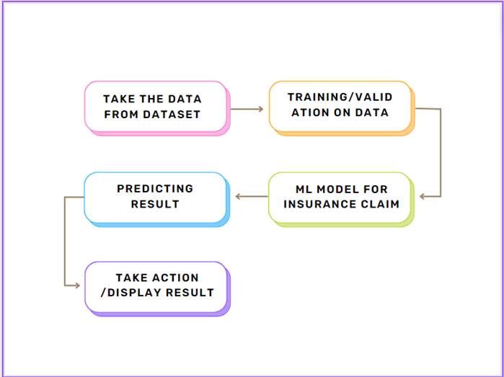
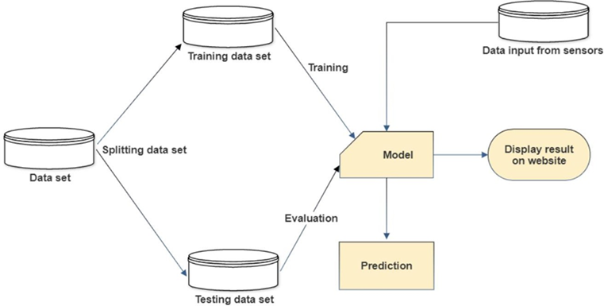
Architecture

Slide 5
Step 1: Data Preprocessing and EDA
Raw data contains 7 columns: age, sex, BMI, children, smoker, region, charges
We used DataPrep module to perform EDA on the data.
We only selected the important parameters and dropped the unnecessary columns.
Insurance claim can be calculated using these parameters and it is categorical data.

Slide 6
Step 2: Linear and Lasso Regression
In order to determine the relationship between various characteristics, we first tried to build a basic linear regression model.With Linear regression, we found, age is highly correlated with sex.
Because each parameter we used was scarce, no correlation could be seen between them.
Moreover, cross validation was done.
Lasso Regression was used, but we still received the same outcome. Hence, we switched to a different model.

Slide 7
Step 3: Decision Tree Regressor
Following linear regression, we attempted to build decision trees, which originally produced 100% R2 scores on training data but 78% R2 scores on testing data. This demonstrates how severely our model has overfitted.To reduce the overfitting problem, we used the 5-fold cross validation which reduced the problem somehow but still the model was dumb.
We used the hyper parameter adjustment to further resolve the issue. GridSearchCV was used, and although it took about 17 minutes, the outcomes were quite good.
The R2 score after hyperparameter adjustment was 77%. Even after experimenting with various parameters, we were unable to surpass the R2 score of 80%.

Slide 8
Step 4: Random Forest Classifier
The model was initially overfit by 98.5% on train data and by 90% on test data using Random Forest Classifier.
Following Hyper parameter adjustment, we improved R2 scores on train and test data to 91 and 89, respectively. The most generalised model we have developed to yet is this one.
After that, we set all AQI values above 500 to be equal to 500.
After normalizing the AQI values, we then again applied Random Forest.
Despite the fact that Random Forest is unaffected by outliers, adjusting AQI resulted in a far better model that provided 92% accuracy on training data and 91% accuracy on testing data.
When Random Forest was tested on unseen data, we obtained numbers that were fairly close to or exactly correct.

Slide 9
Frequent Q&A
Q) What is the source of the data?
Although city-specific data can be obtained from that particular insurance provider or bank, the data was obtained from Kaggle.
Q) What is the complete flow of your project?
For a better understanding, see slide number 4.
Q) What techniques were you using for data pre-processing?
Data pre-processing involved analysing the data, identifying the key characteristics, and removing the irrelevant columns based on the domain expertise. We also attempted to replace any missing values with the mean, median, and mode, but the correlations between the data remained the same. The better choice for us was to remove the columns with high NaN values.

Slide 10
Frequent Q&A
A1: How can information help in decision-making?The graph that came before this one is now updated. Also, it displays the same things with a little more value information.Variables are ranked according to importance in descending order.Impact: The horizontal placement indicates whether a higher or lower prediction is implied by the influence of that value.
A2: How can an individual's previous insurance claims alter the system's output?After receiving a response to the initial query, the client may request a previous insurance claim. How does the output of the system vary when past claim values change even when other parameters do not?Let's talk about the Partial Dependence Plot to address this (PDP)PDP depicts the relationship between the characteristic and the target reaction. Some characteristics are diminished. This graph demonstrates how altering the value of Insurance Claims alters the expected result. It shows that as the value of an insurance claim rises, so does the likelihood of a car accident.

